Slide 1



Multi-modal data integration using deep learning and applications in precision oncology
Dr. Bora Uyar
Computational Genomics Workshop
10-16 March 2025

Slide 2
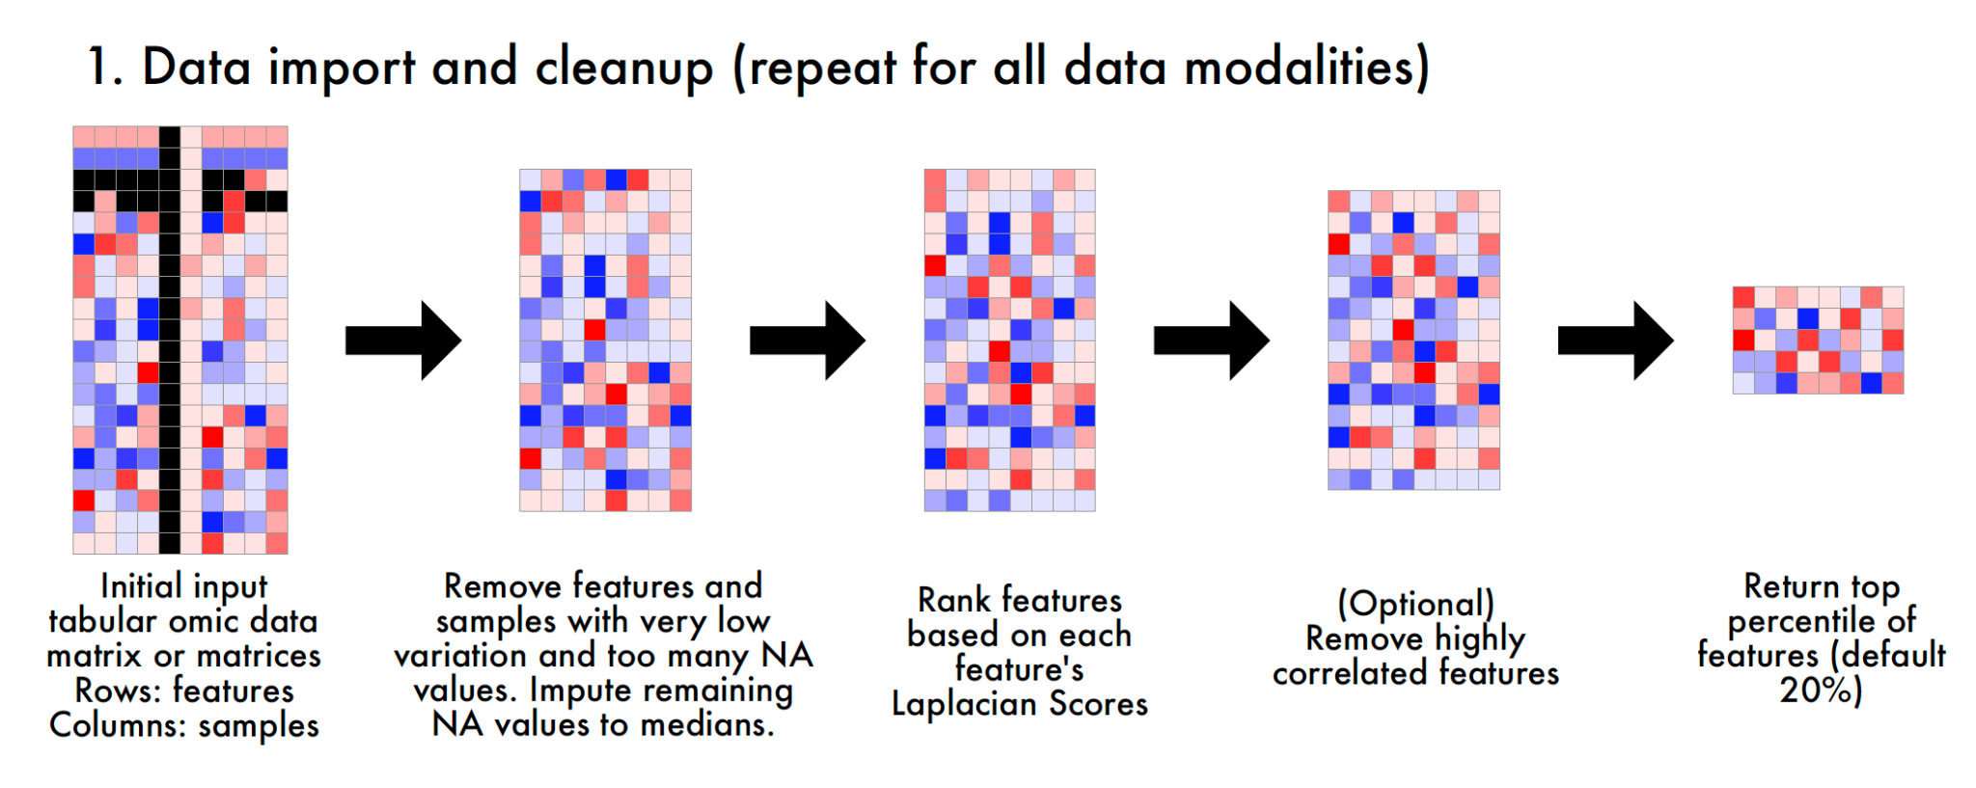
Data Import

Slide 3
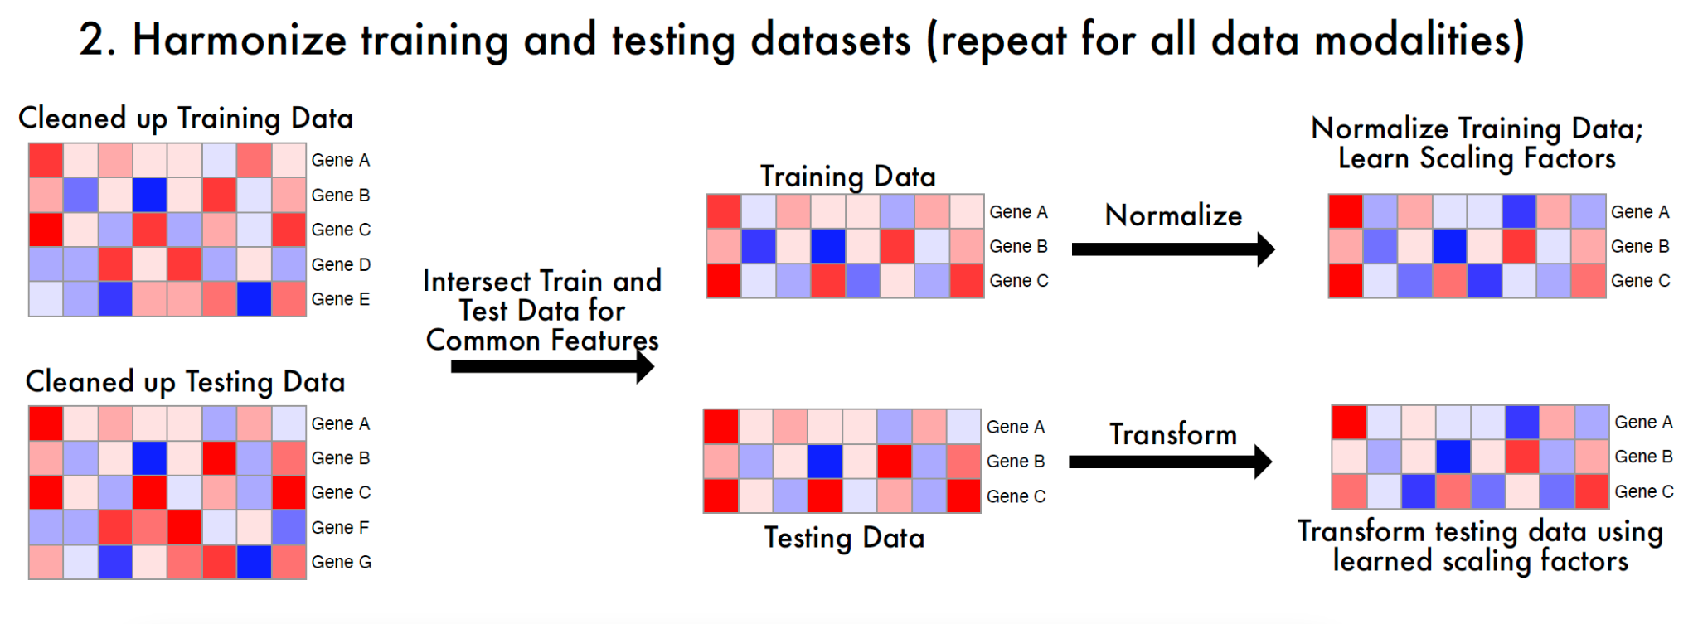
Data Import

Slide 4
Important Terms
Neurons/Nodes
Layers: input layer, hidden layers, output layer
Loss functions
Learning rate
Batch size, batch iterations, epochs
Hyperparameter optimization

Slide 5
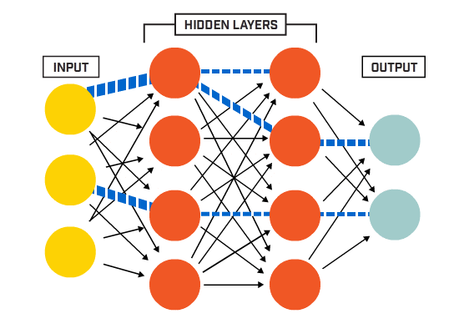
Components of a neural network
Introduction to Neural Networks and Their Key Elements (Part-C) — Activation Functions & Layers | Towards AI

Slide 6
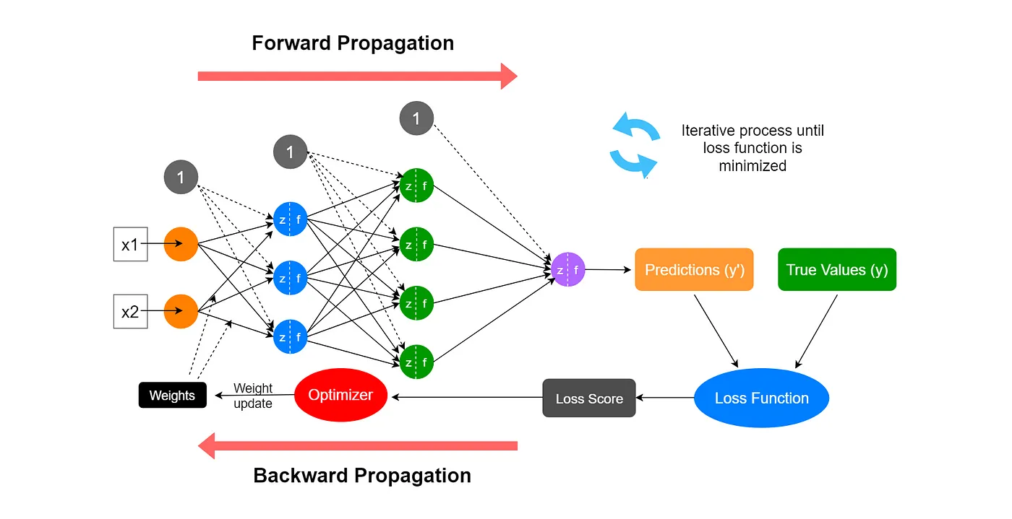
Training Process
Decoding Backpropagation and Its Role in Neural Network Learning | ml-articles – Weights & Biases

Slide 7
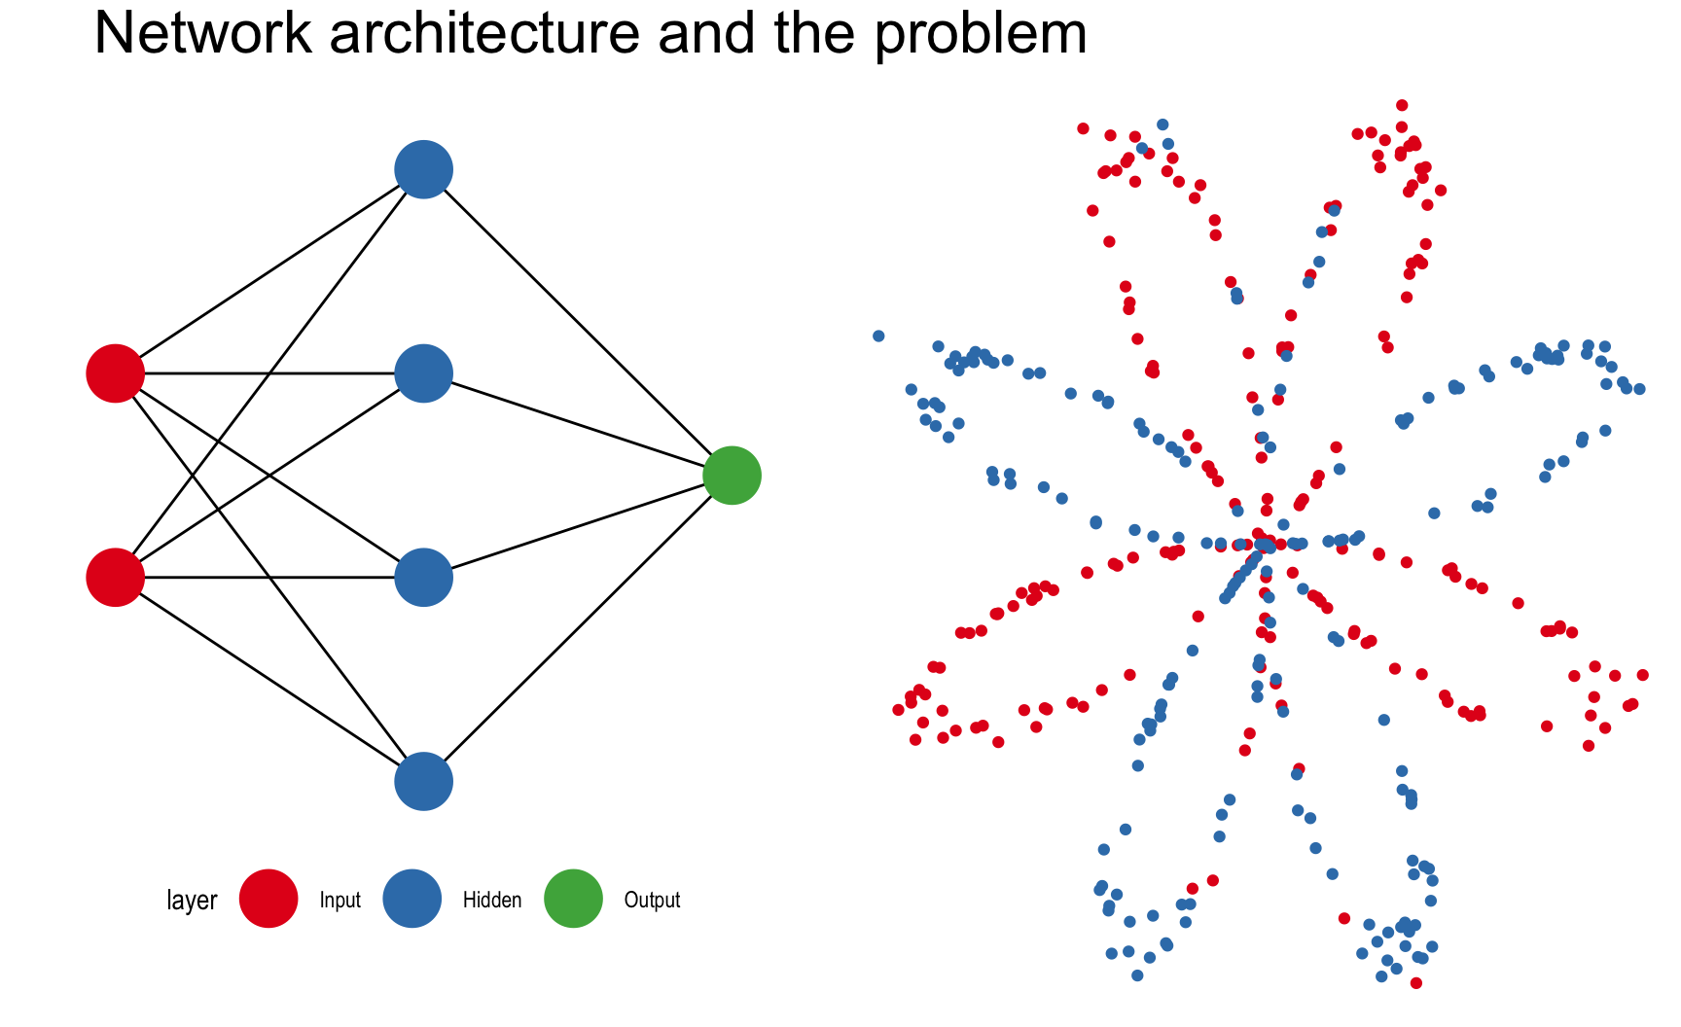
An animated neuRal net implementation

Slide 8
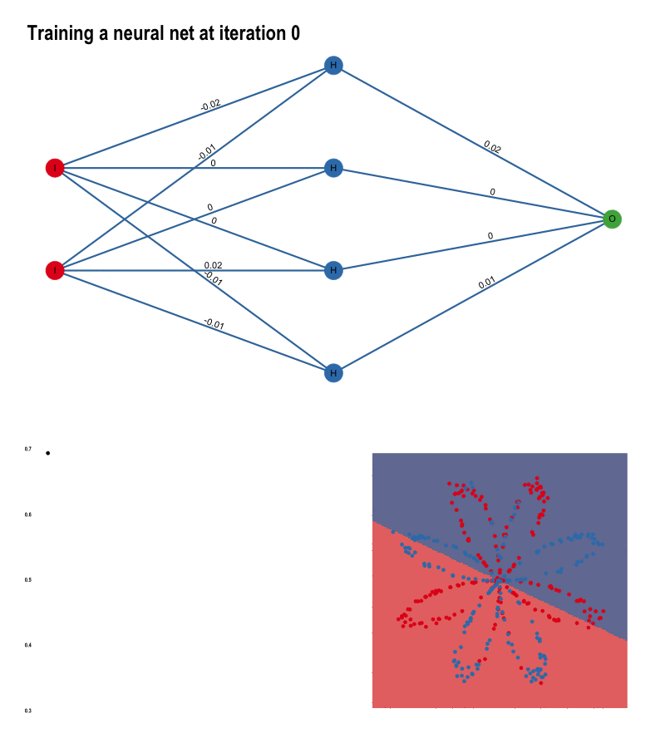
An animated neuRal net implementation

Slide 9

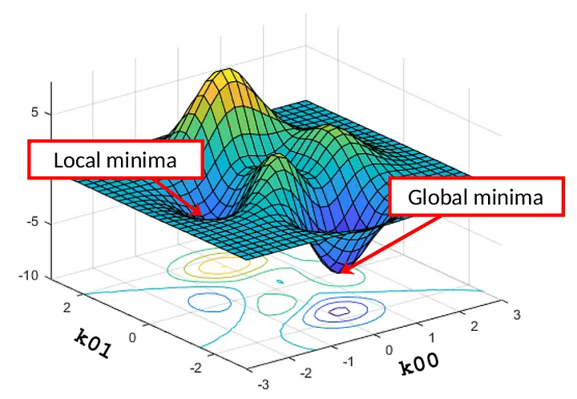
Gradient Descent
Deep Learning from Scratch in Modern C++: Gradient Descent | by Luiz doleron | Towards AI

Slide 10
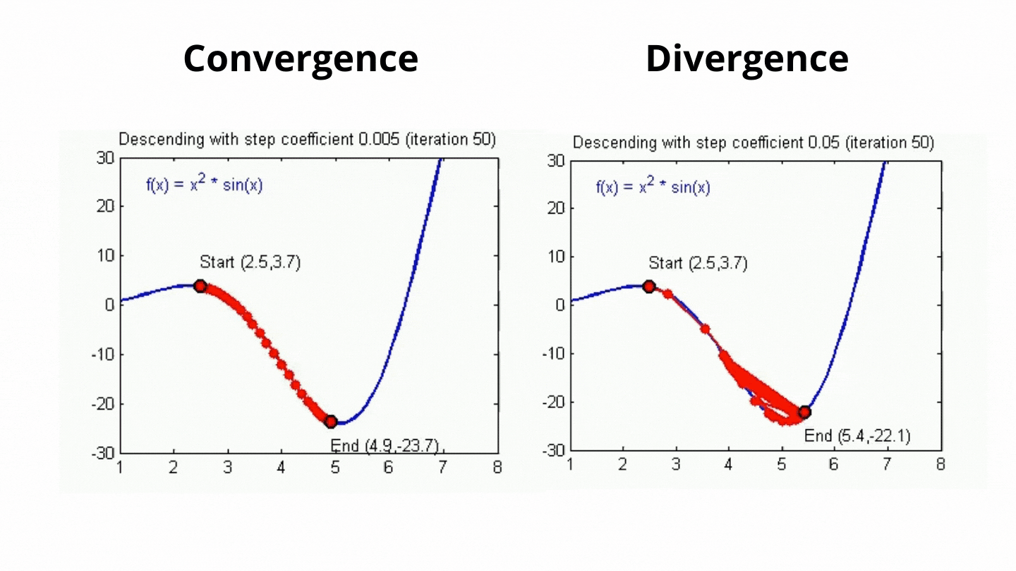
Impact of the learning rate
Mastering Gradient Descent: Optimizing Neural Networks with Precision. | by om pramod | Medium

Slide 11

Setting the learning rate of your neural network.

Slide 12
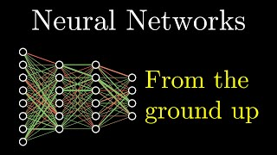
Recommended:

Slide 13
Batch iterations, epochs, HPO iterations
1000 samples
batch size: 200
5 batch iterations = 1 Epoch
Batch iteration < Epoch < HPO iteration
Epochs, Batch Size, Iterations - How are They Important to Training AI and Deep Learning Models

Slide 14
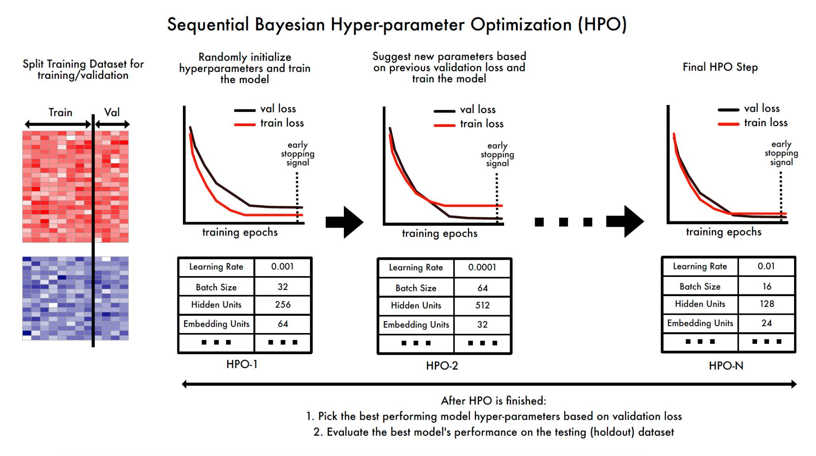
Hyperparameter Tuning

Slide 15
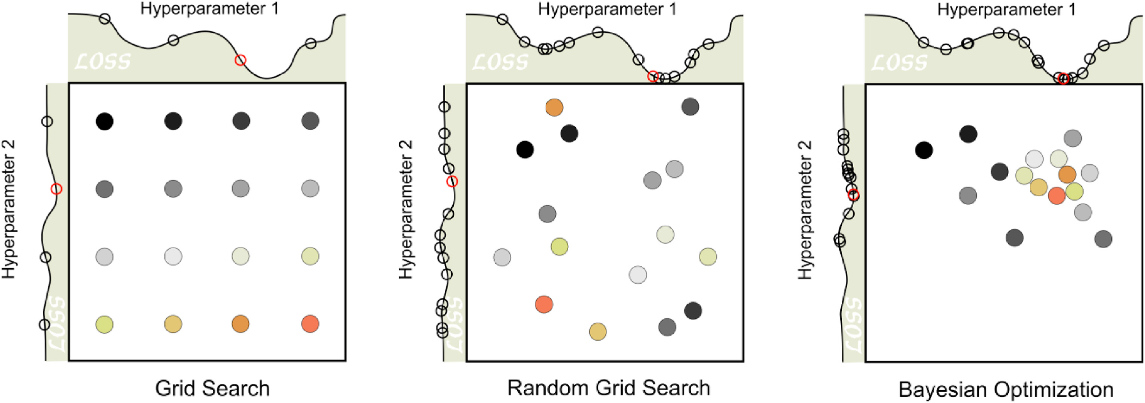
Hyperparameter tuning
A tutorial on automatic hyperparameter tuning of deep spectral modelling for regression and classification tasks - ScienceDirect

Slide 16
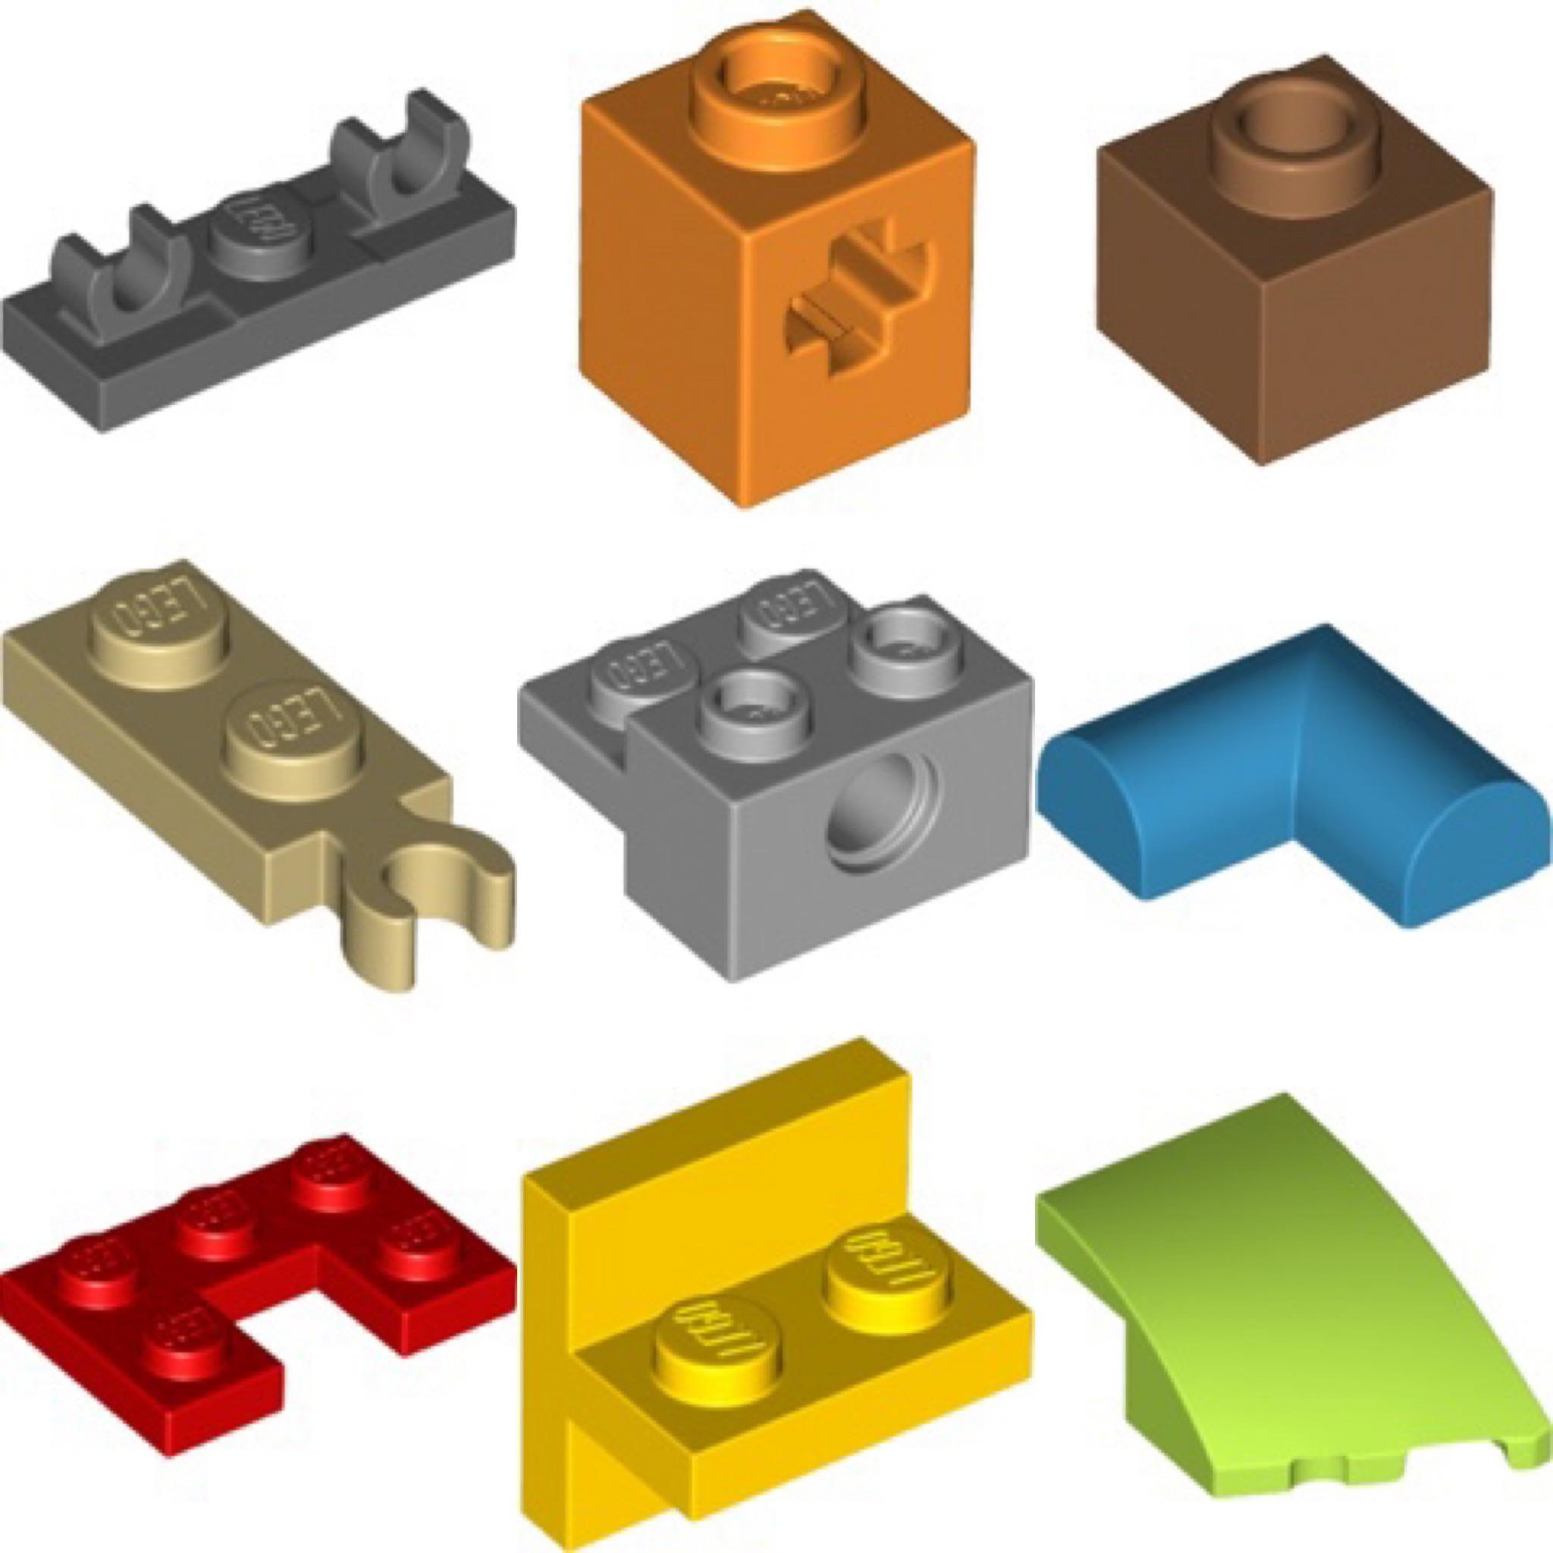
Neural Network Layers can be combined like Lego pieces

Slide 17
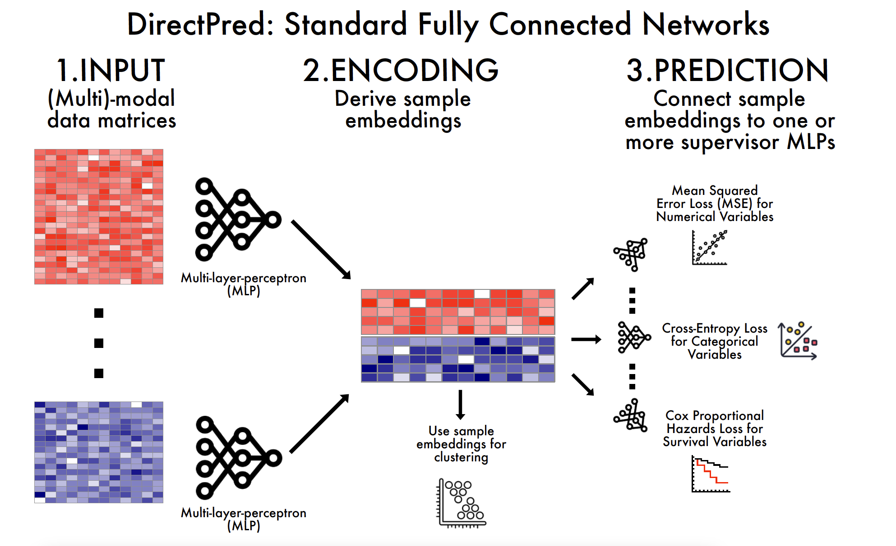

Slide 18
Homework
https://github.com/BIMSBbioinfo/compgen_course_2025_module3/tree/main/homeworks/hw2

